Slide 1
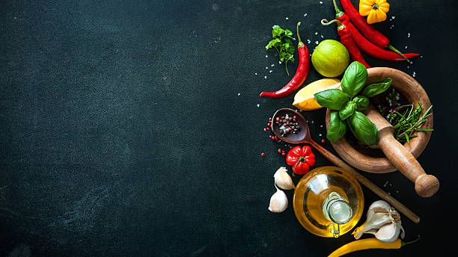
Recipes Book
Thug
Kitchen
By :K .Srivalli , K .Lekhana
Ch .Indhu , R .Pavani
By :K .Srivalli , K .Lekhana
Ch .Indhu , R .Pavani

Slide 2
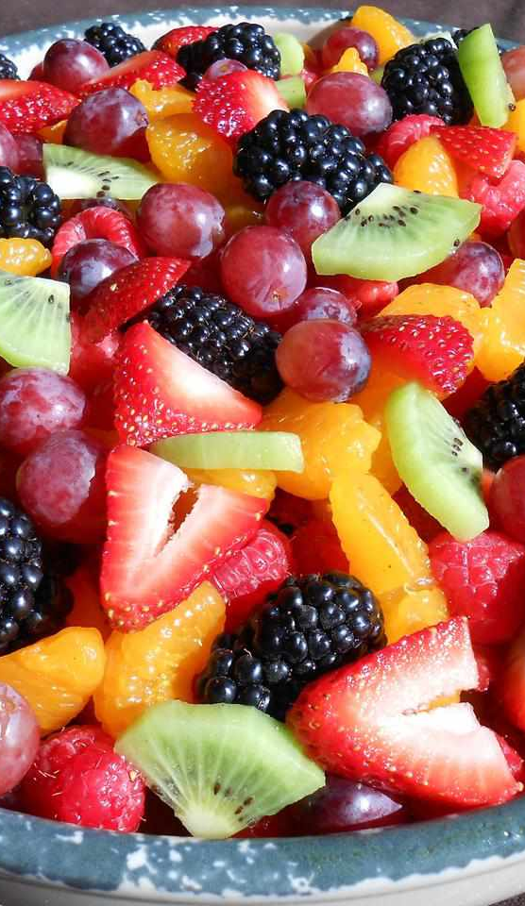
Title of the project : Thug Kitchen Introduction: A recipe book is a map of directions explaining how to prepare and cook various kinds of food . Our website is not just a collection of recipes; it's an immersive journey into the world of flavors. Our purpose is simple yet profound: to ignite your passion for cooking and elevate your culinary skills . In this virtual kitchen, we blend passion and expertise to offer a diverse array of recipes suited for both kitchen newcomers and seasoned chefs. From the sizzle of the pan to the aroma of freshly baked delights, our collection captures the essence of culinary artistry .

Slide 3
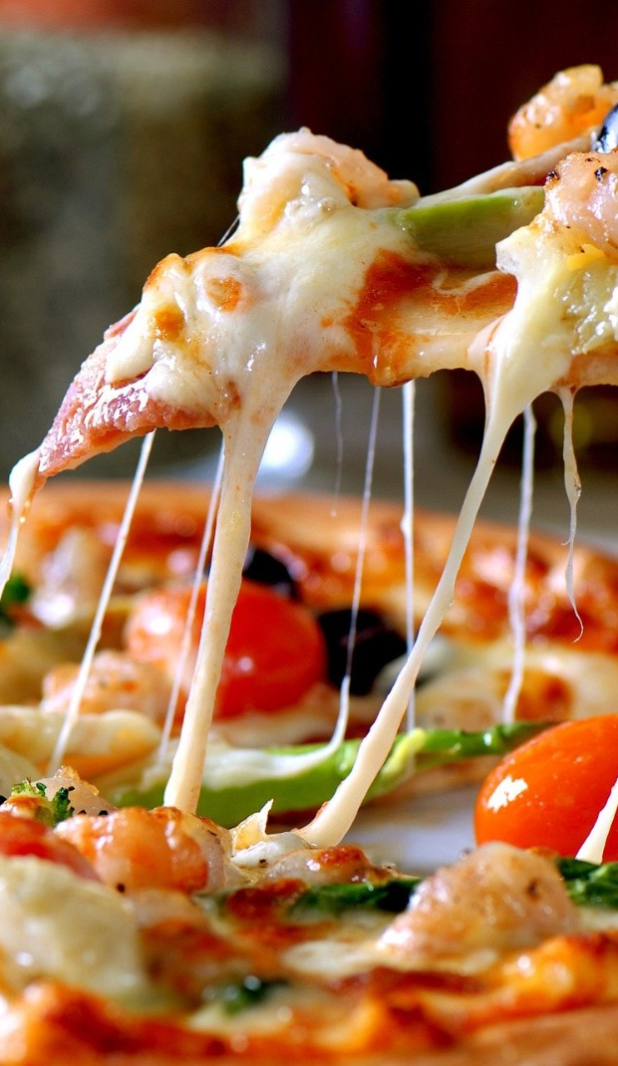
Objective: This project is about Recipes Book . This website helps for novice cooks, a recipe book provides step-by-step instructions and it also provides us with some YouTube links of that particular dish helping them learn fundamental cooking techniques and build confidence in the kitchen.

Slide 4

Team Members
K . Srivalli
-21A91A04L8(Frontend)
K . Lekhana
-21A91A04L2(Frontend)
Ch . Indhu
-21A91A04J3(Frontend)
R . Pavani
-21A91A04O7(Backend)

Slide 5
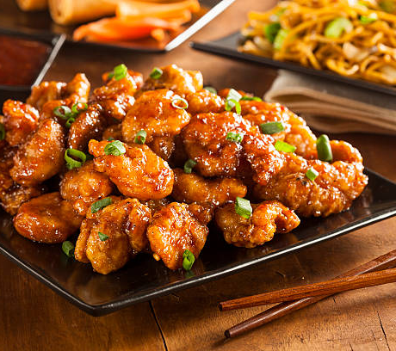
Technologies Used
TECNOLOGIES
1
React Js
2
Node Js
Bootstrap.
3
4
Cascading Style Sheet(CSS)
5
Express Js
6
Mongodb

Slide 6
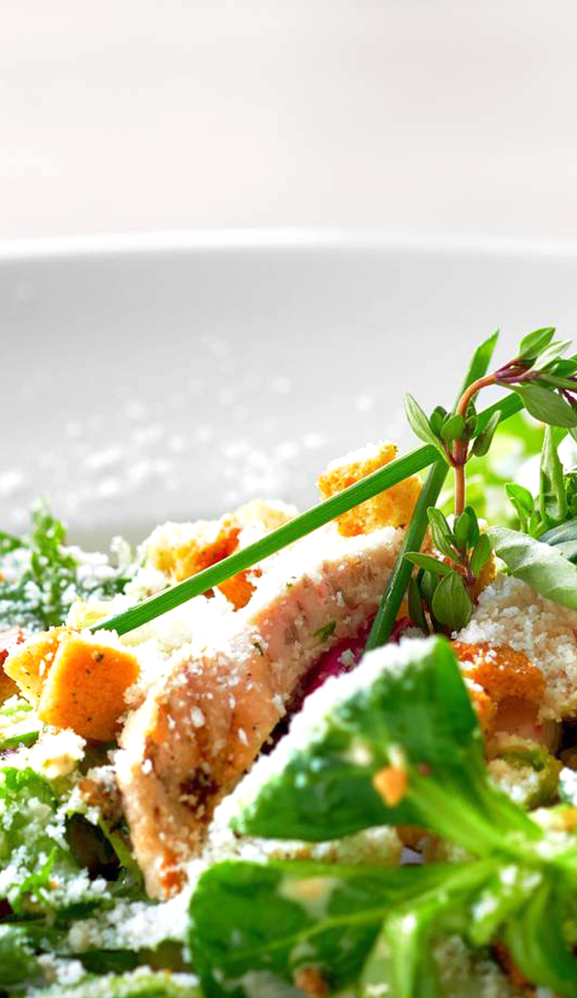
Methodologies:
frontend
Some Important Methodologies
useState
useEffect
axios
React-router- dom
React
Carousel
Marquee
Salt and pepper to taste
Carousel: React Carousel is a slideshow inside a bunch of content. It launches many images, text, or HTML elements and supports previous/next buttons.
useState: useState is React Hook that allows you to add state to a functional component. It returns an array with two values: the current state and a function to update it.
useEffect: The useEffect Hook allows you to perform side effects in your components. Some examples of side effects are: fetching data, directly updating the DOM, and timers. useEffect accepts two arguments.
Node mailer: The Nodemailer module makes it easy to send emails from your computer.
Multer: Multer is a node. js middleware for handling multipart/form-data , which is primarily used for uploading files.
BAckend
Cors
Express
Node Mailer
Multer
body-Parser

Slide 7
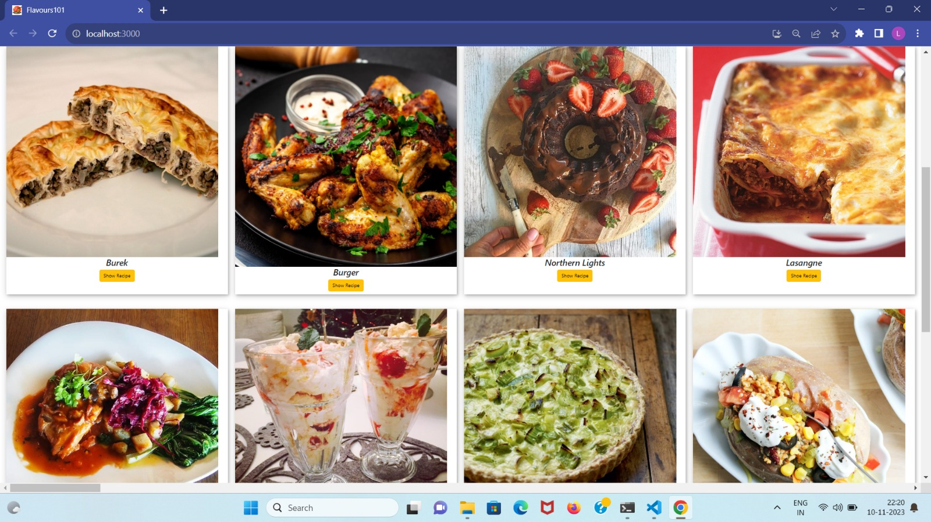
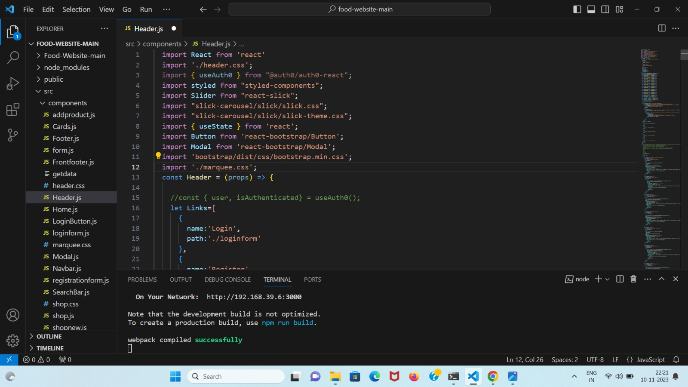
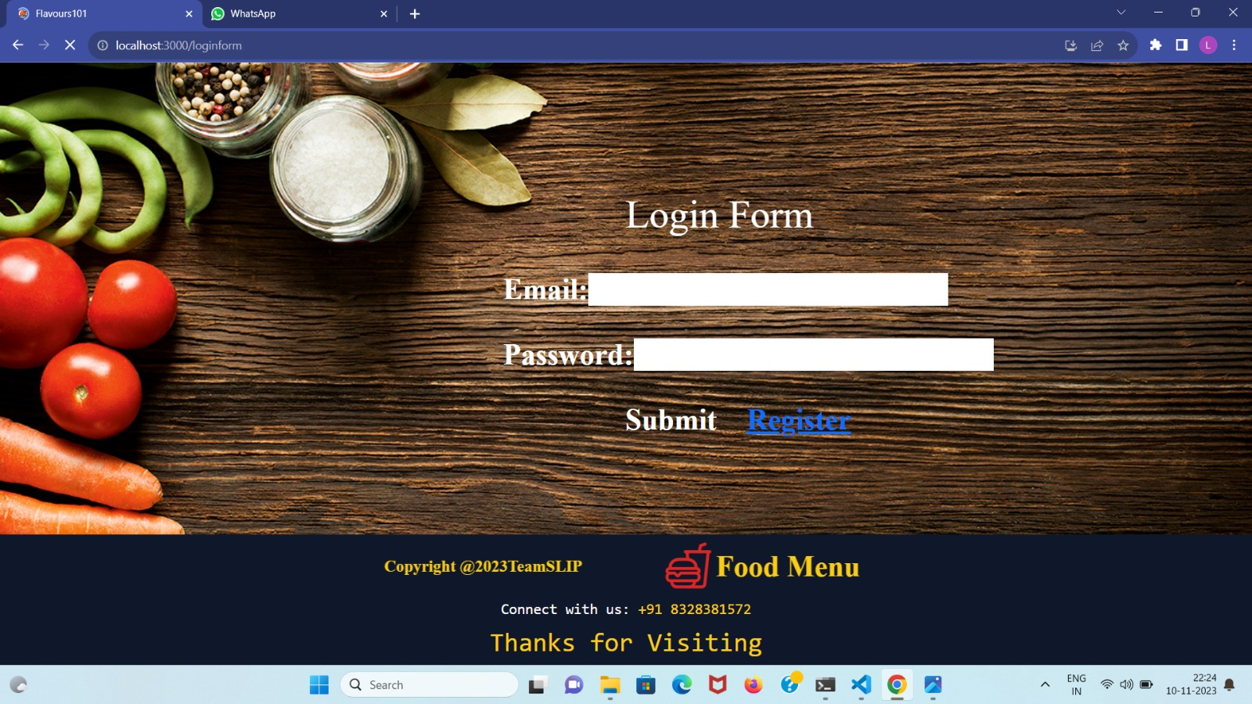
Work Accomplished

Slide 8
Challenges Faced:
While doing Login authentication.
Adding data dynamically.
Results and Finding:
By through this project we learned the storing data dynamically
using multer concept in backend.
We came to known the usage of nodemailer in real time applications or app designing.
While doing this project we came to known the real time data maitainance
Through mongodb. The data is stored in the form collection with unique id.

Slide 9
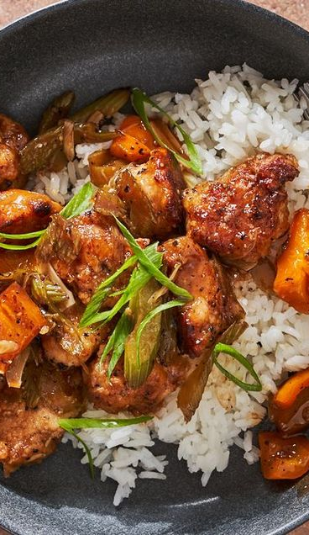
Modules Used
1.Register page
Firstly the user should register to the website with
specified password and username.
2.Login page
After registration it will redirects to login page it
contains password and username.when we enter
the correct details it will redirects to Home page
or else it swing to register page.

Slide 10
3.Home page
Home page contains search bar.When we search
any recipe it displays the searched recipes and related
Recipes in a card formate .If you want to known the
procedure of any recipe click on show button. Then it
shows the step by step procedure of that recipe or
else if we want to see the video click on watch vedio
the it will redirect to youtube
4. Add a recipe
when we click on add a recipe it swing to form.
The form contains recipe name and recipe procedure.
When we submit the form the formdata is stored in
backend . And the same time we can get the data to
front webpage using get method in backend.

Slide 11

Conclusion:
Conclusion:
The summary of our recipe book website is the collection
of recipes, instructions, and information about the preparation. At
last I want to conclude that food and health both are related to each
other . our health depends upon what food we eat and how much
we eat. Therefore we should be careful while eating . The that seems
nice to taste can may bad to health.” Healthy people eating healthy
food should never need to take an antibiotic ”.If you don’t want to take
antibiotic just follow our recipe book instructions.

Slide 12
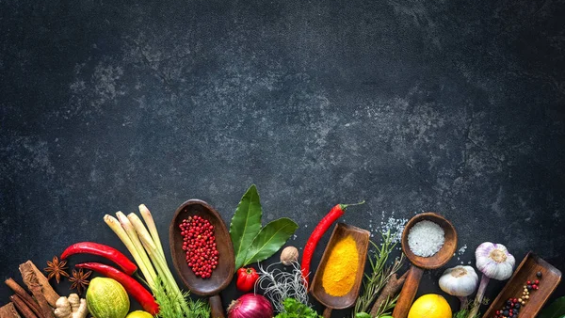
Conclusion:
Thank You

